Slide 1



Moving service system
Kuanysh Amandos, se2001

Slide 2

agenda
Project idea
Progress
Problems
Conclusion

Slide 3


project Idea

Slide 4

progress
Research material
Creating in SQL
Insert examples
Fix bages

Slide 5
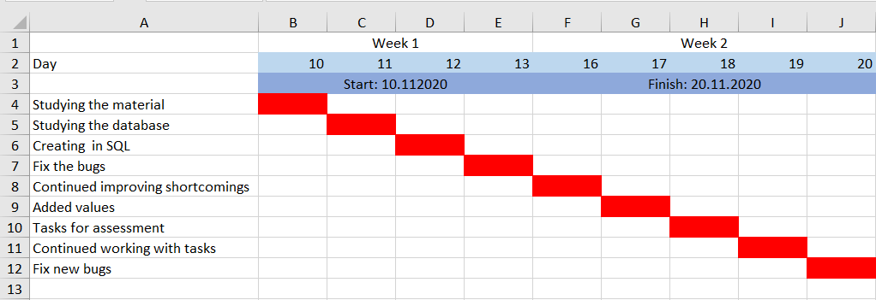
Gantt char

Slide 6
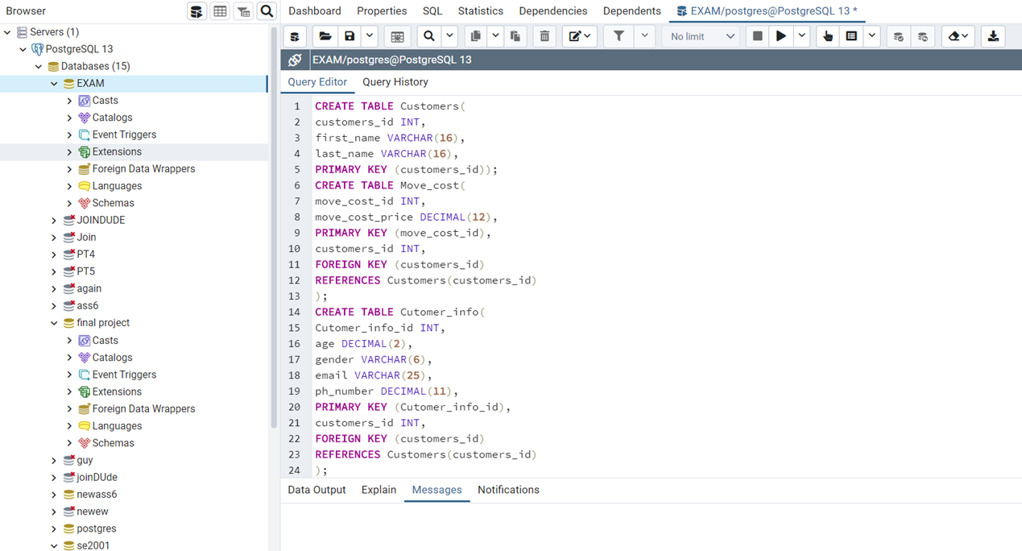
Progress of creating

Slide 7
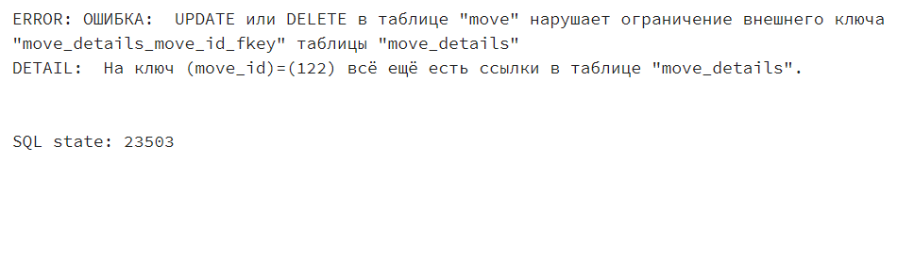
problems i faced
Right connections
How to connect tables
NULL
How to add NULLS
Delete commands
Problems with commands

Slide 8

conclusion

Slide 9
References
American Moving & Storage Association. American Moving & Storage Association – Industry Fact Sheet. Retrieved May 9, 2015, from http://www.promover.org/
Paul, R. (2011, April 10). A guided tour of the Microsoft Command Shell. Ars Technica. Retrieved from https://arstechnica.com/
Stellin, S. (2007, July 29). The Movers Are Here. Have You Done Your Homework?. New York Times. Retrieved from https://www.nytimes.com/
United Van Lines. Moving Company: America's #1 Mover. Retrieved November 19, 2020, from https://www.unitedvanlines.com/
Wikipedia (n.d) Moving company. Retrieved October 17, 2020, from https://en.wikipedia.org/wiki/Moving_company

Slide 10

Thanks for attention
Kuanysh Amandos

